Slide 1
Data visualization
Hi! PARIS DataBootcamp 2025

Slide 2







📚Lecturer - Soobash Daiboo - Senior ML Engineer
Work Experience
Contact Info
www.linkedin.com/in/soobash-daiboo/
www.github.com/soobash
soobash@gmail.com
👨🏼‍🏫 Course Provided by Soobash Daiboo ©

Slide 3
Agenda
What is Data Visualization ?
Main types of visualization plots
Exploratory Data Analysis (EDA)

Slide 4


What is Data visualization ?

Slide 5
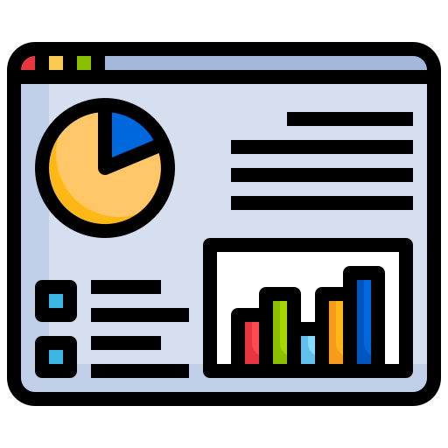
What is Data visualization ?
Data visualization is the representation of data through the use of graphics, such as charts/plots, maps, and interactive dashboards

Slide 6



What is Data visualization ?
Data visualization is the representation of data through the use of graphics, such as charts/plots, maps, and interactive dashboards
Identify Patterns and Trends
Detect trends or anomalies that aren’t apparent when looking at raw data
Easily communicate insights
Summarize data into visual representations that are easier to comprehend
Support Decision-Making
Absorb information quickly and make informed decisions based on the information provided.

Slide 7
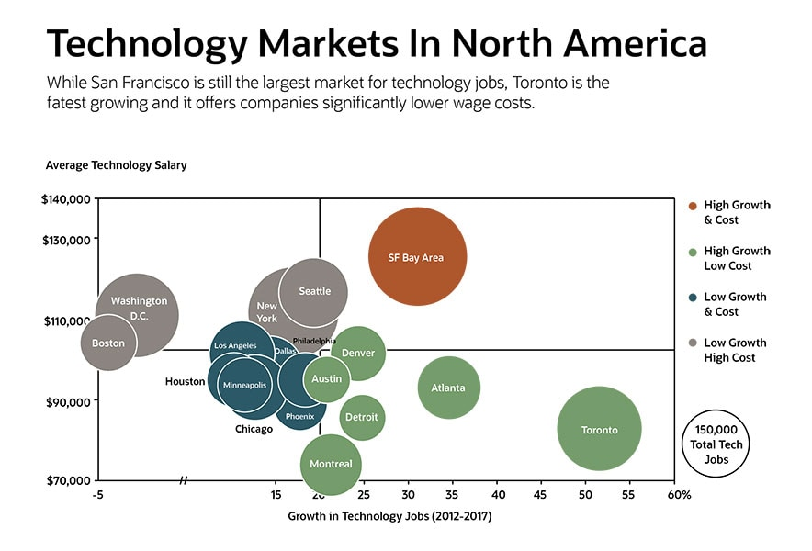
What is Data visualization ?
Charts and plots
Summarize data in a graphical form and display it along two or three axes.
Data can be represented as points, lines, curves , areas, bars…

Slide 8
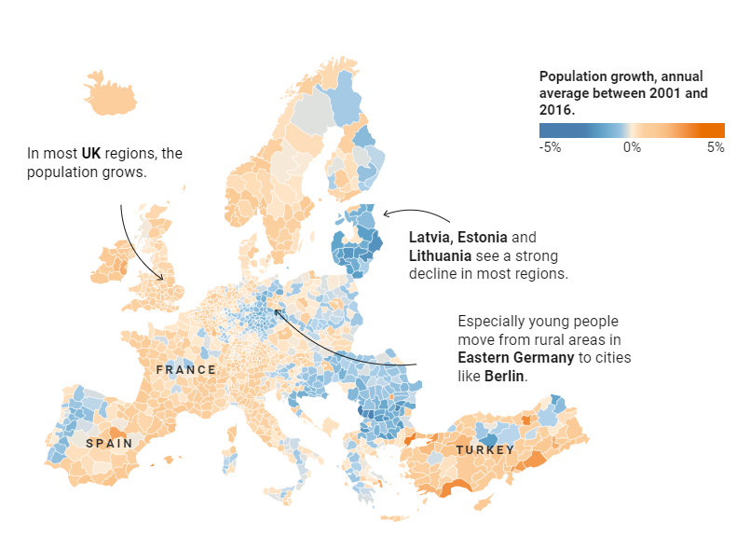
What is Data visualization ?
Maps and geospatial plots
Represent data on a map, with
geographical information and spatial relationships.
Types of geospatial plots: choropleth, locator, symbol …
Population growth per region with a choropleth map

Slide 9
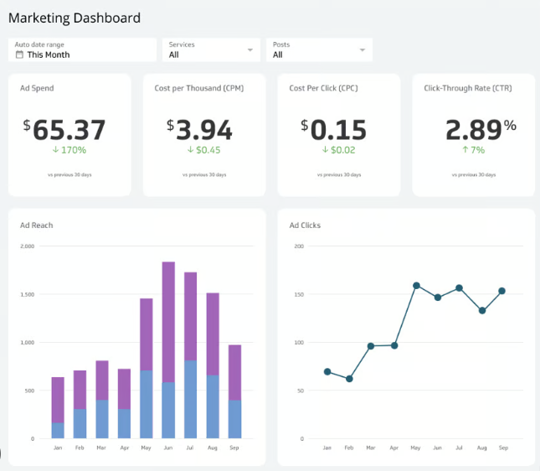
What is Data visualization ?
Interactive dashboards
Collection of charts that summarizes key indicators and displays data interactively
Get a real-time snapshot of KPIs and other important metrics.
Users can personalize the information shown
Dashboard with marketing KPIs
(Ad Spent, cost per thousand, …)

Slide 10
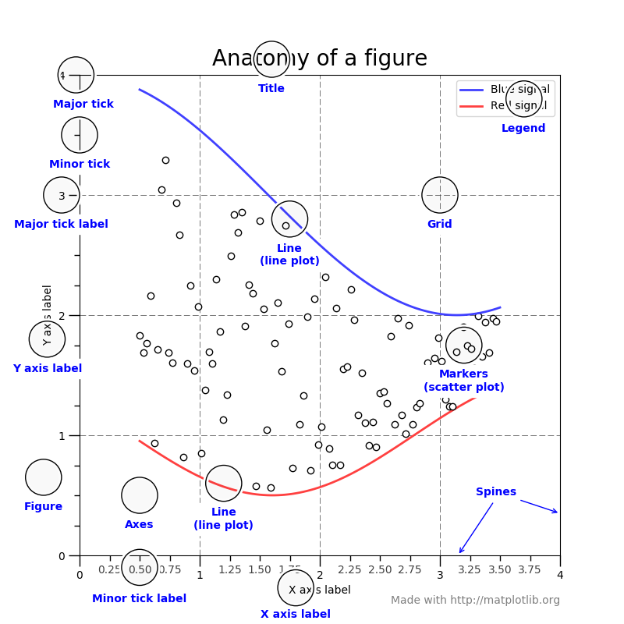

Visualization tools: Plotting libraries (Python)
Advantages:
Widely used, many tools to customize plots (titles, legends, labels,…)
Disadvantages:
Verbose syntax, aesthetically lacking

Slide 11

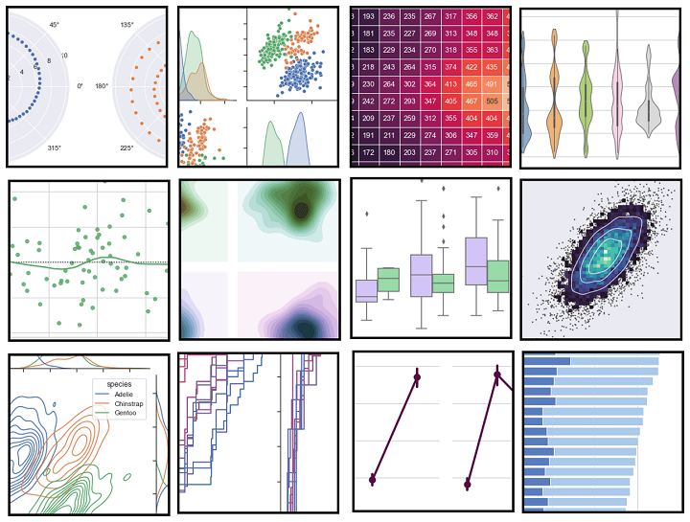
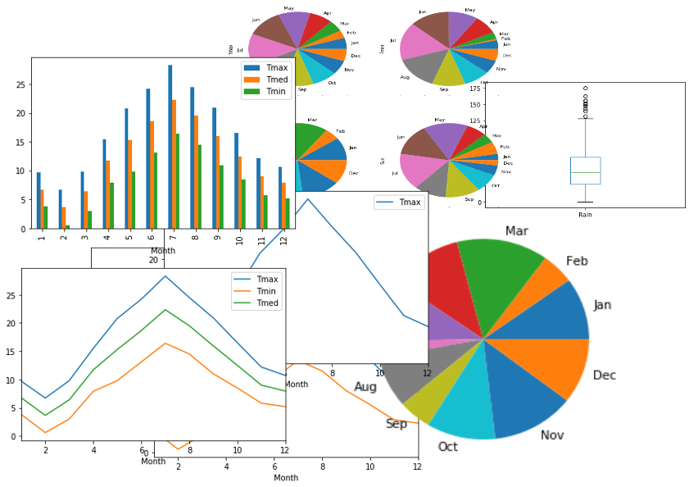

Visualization tools: Plotting libraries (Python)
Less customizable but better aesthetics
Many statistical plots & charts
Better suited for datasets
Easy API to create plots with Series/Dataframes
Interface to Matplotlib plots

Slide 12

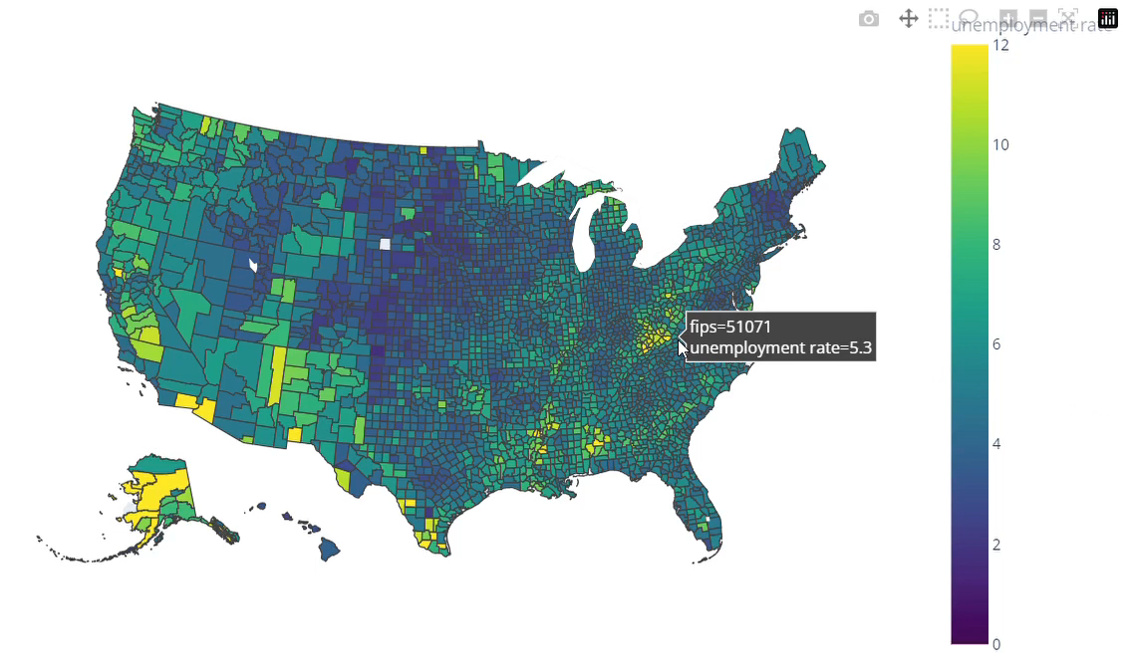
Visualization tools: Interactive plotting library
https://plotly.com/python/
Interactive plotting library
Create interactive plots & dashboards
Key features:
Wide range of plots: charts, maps, …
High-level plotting library: plotly express
Web application framework: Dash
Interactive Choropleth map
Map of average unemployment rate per US county (FIPS)

Slide 13

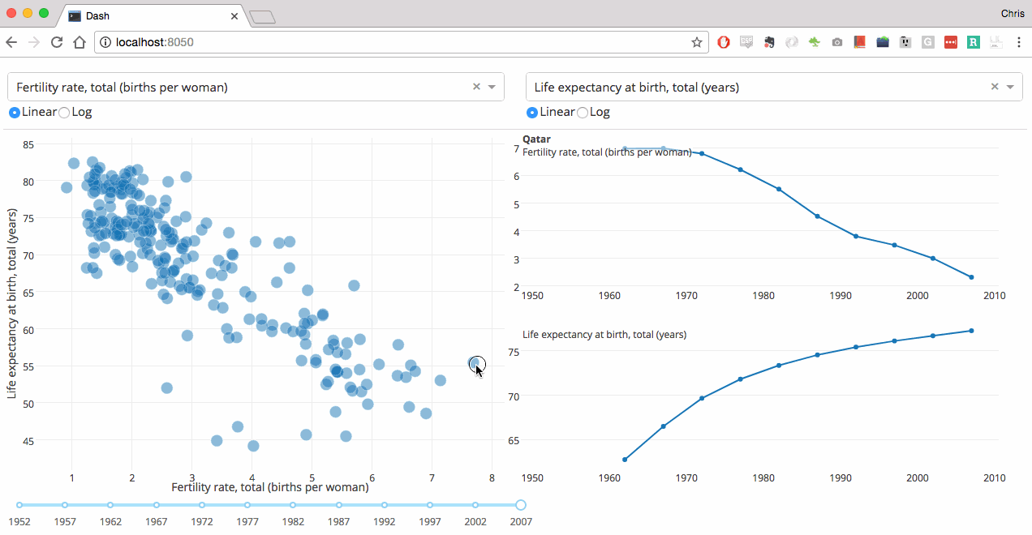
Visualization tools: Dashboard apps
Plotly framework for web apps
Interactive dashboards with plotly components
Key features:
Build a web interface without full-stack development
Deploy open-source apps with external hosting platforms
Dash Entreprise: Create, share and deploy apps at scale

Slide 14
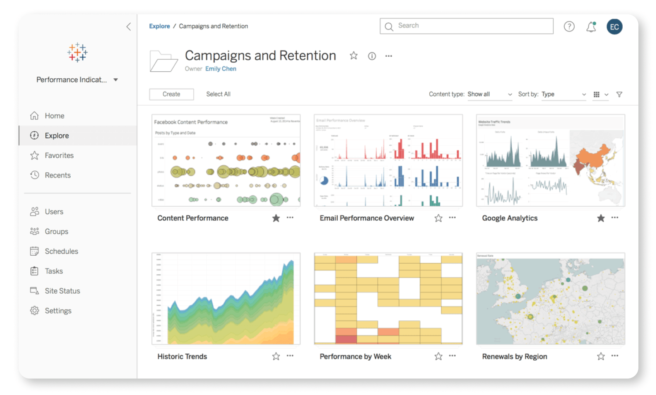
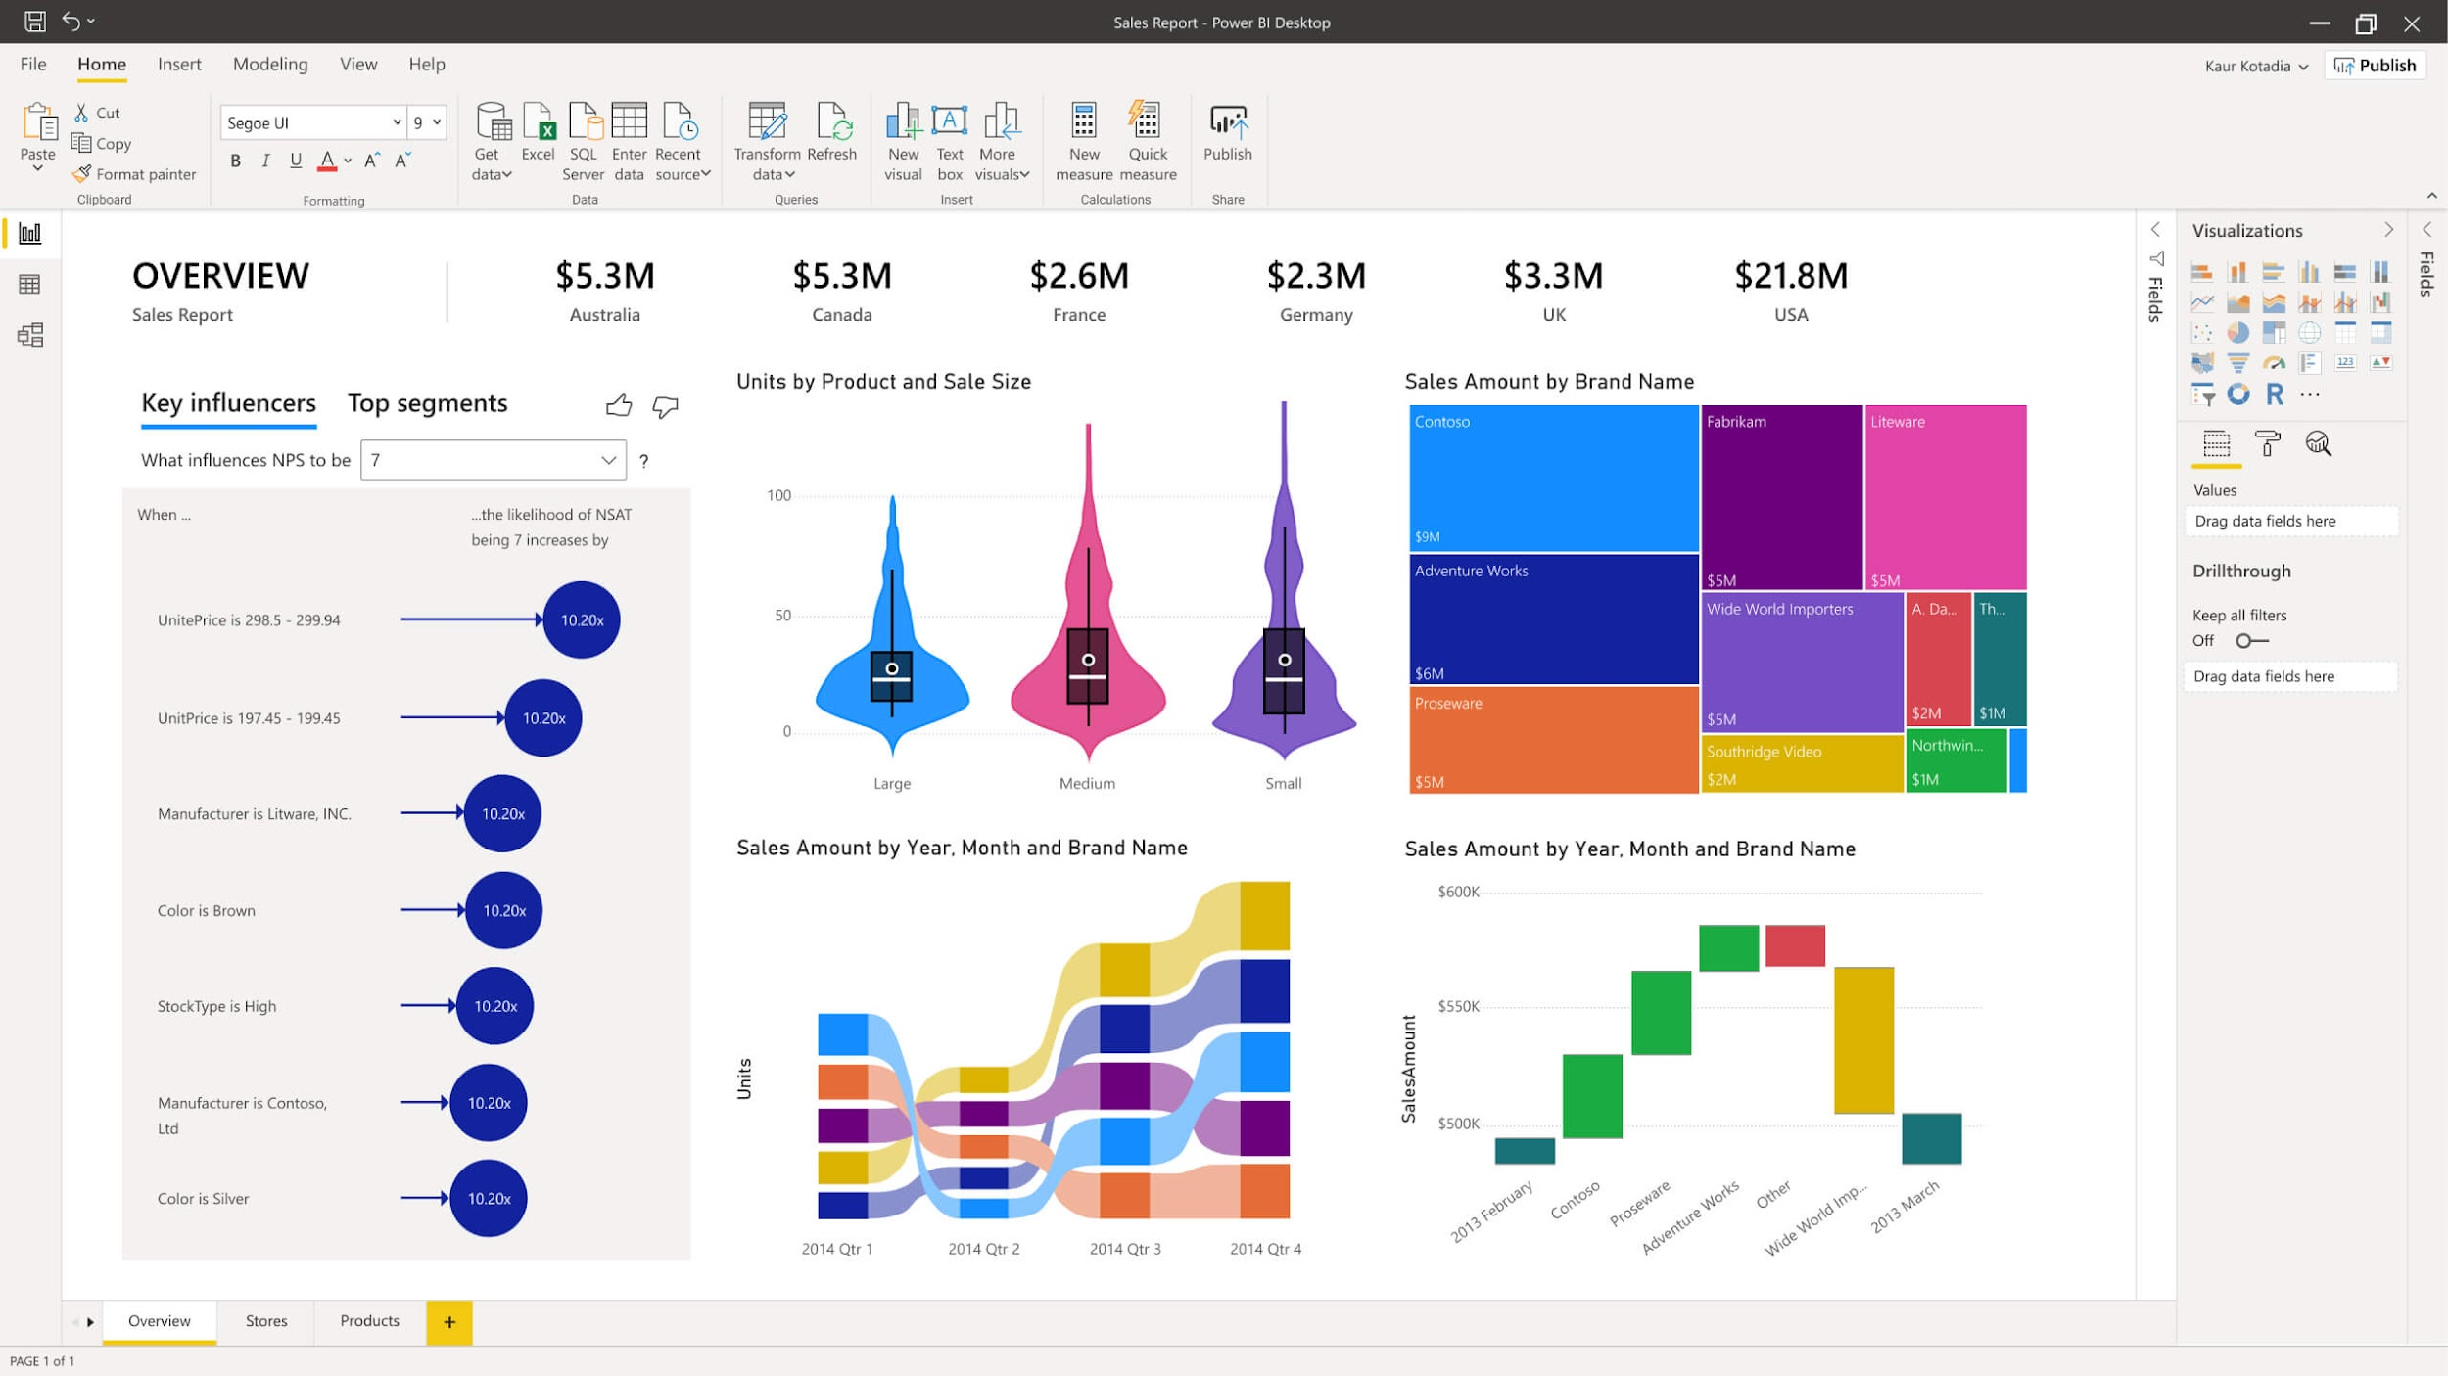
Visualization tools: Other frameworks
Tableau
Power BI
Business Analytics Softwares

Slide 15

Main types of visualization plots
Distribution, Relationship, Comparison, Composition

Slide 16
Distribution plots: Histograms
Histograms are graphs that represent the distribution of a single variable.

Slide 17
Distribution plots: Histograms
Histograms are graphs that represent the distribution of a single variable.
They show how frequently each range of values, or “bins”, appear in the dataset

Slide 18
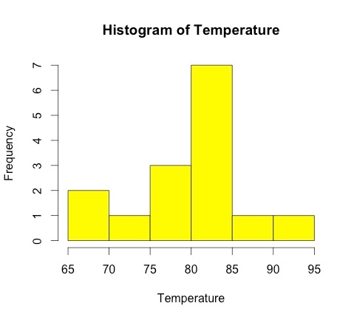
Distribution plots: Histograms
Histograms are graphs that represent the distribution of a single variable.
They show how frequently each range of values, or “bins”, appear in the dataset
Each bin represents a range of values (65-70, 70-75, …)

Slide 19
Distribution plots: Histograms
They are useful to study the location, range and skewness of a distribution
They can help identify biases or extreme values in the data

Slide 20
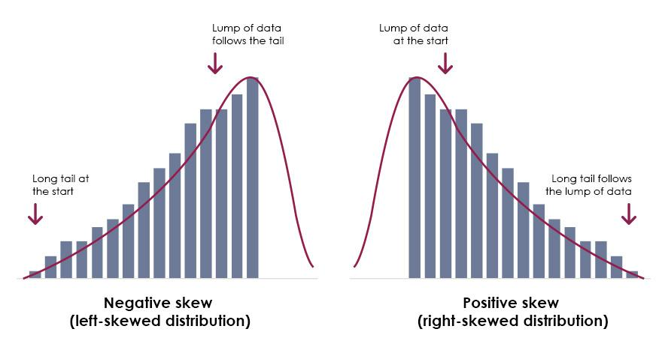
Distribution plots: Histograms
They are useful to study the location, range and skewness of a distribution
They can help identify biases or extreme values in the data
Small extreme values
Large extreme values

Slide 21
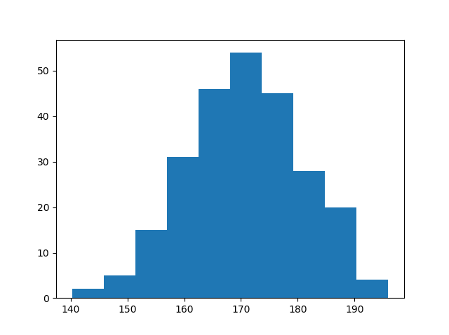
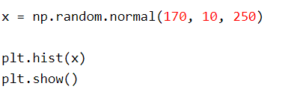
Histograms with Matplotlib

Slide 22
Distribution plots: Boxplots
Boxplots are statistical plots that represent the distribution of a variable around its median value

Slide 23
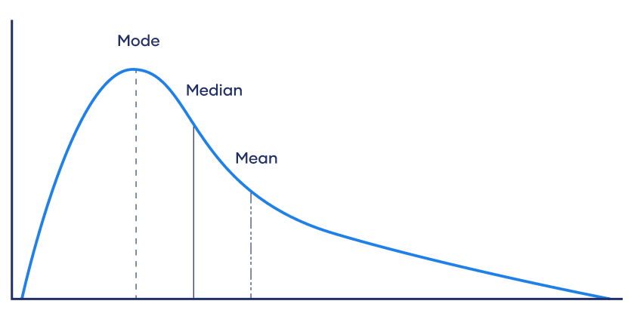
Distribution plots: Boxplots
Boxplots are statistical plots that represent the distribution of a variable around its median value
What is the median value ?
The median divides the data into two equal halves
50% of values are less than or equal to it
50% are greater than or equal to it.
Isn’t as sensitive to extreme values as the mean

Slide 24
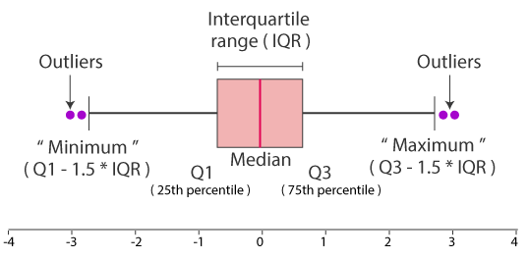
Distribution plots: Boxplots
Boxplots are statistical plots that represent the distribution of a variable around its median value
Median value of the
distribution
Width of the box
Spread/range of the data
Spread/range of the data

Slide 25
Distribution plots: Boxplots
Boxplots are statistical plots that represent the distribution of a variable around its median value
First quartile
(25% is above this value)
Third quartile
(75% is above this value)

Slide 26
Distribution plots: Boxplots
Boxplots are statistical plots that represent the distribution of a variable around its median value
The min and max values determine which points are outliers

Slide 27
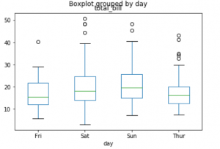
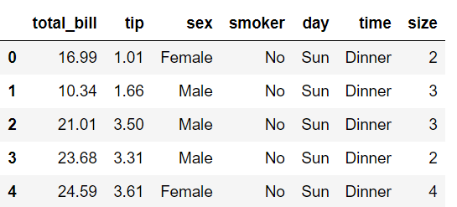
Boxplots with Pandas

Slide 28
Relationship plots: Scatter plot
Scatter plots show the relationship between two numerical variables with dots (or any symbols)

Slide 29
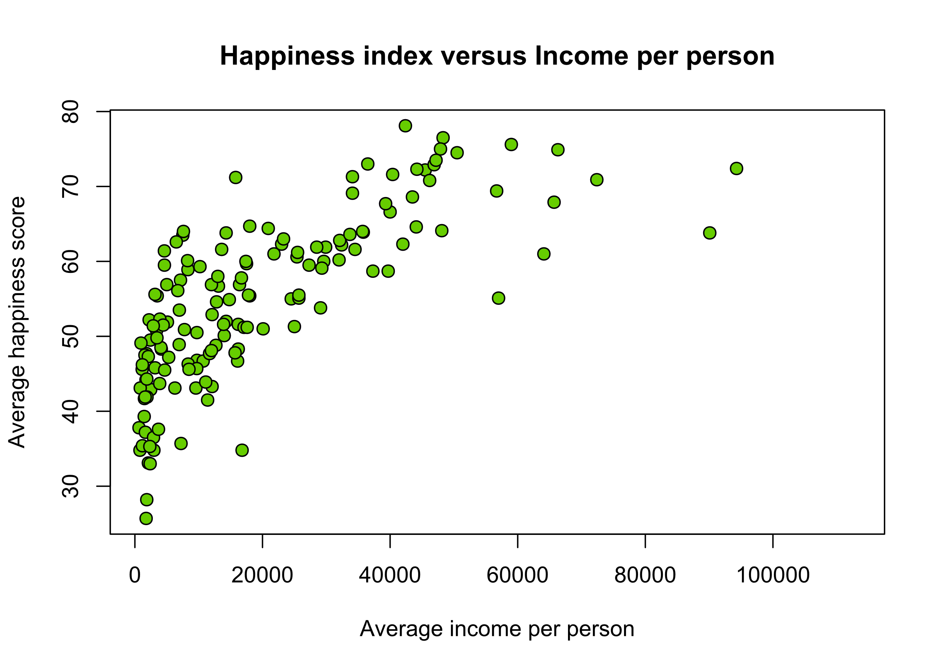
Relationship plots: Scatter plot
Scatter plots show the relationship between two numerical variables with dots (or any symbols)
Each point represents a pair of values,
one for each variable plotted
Happiness: 60
Average income: 62000

Slide 30
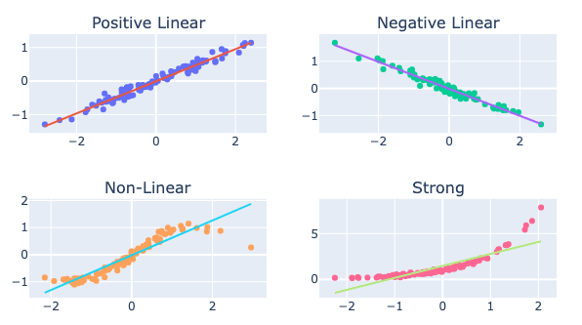
Relationship plots: Scatter plot
They can help identify patterns within the data, such as linear or non-linear relationships (or correlation).

Slide 31
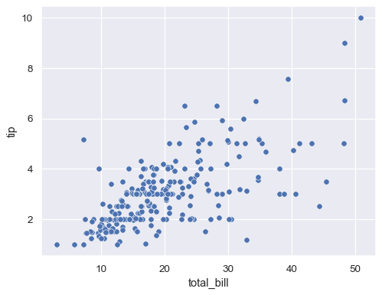
Scatter plots with Seaborn

Slide 32
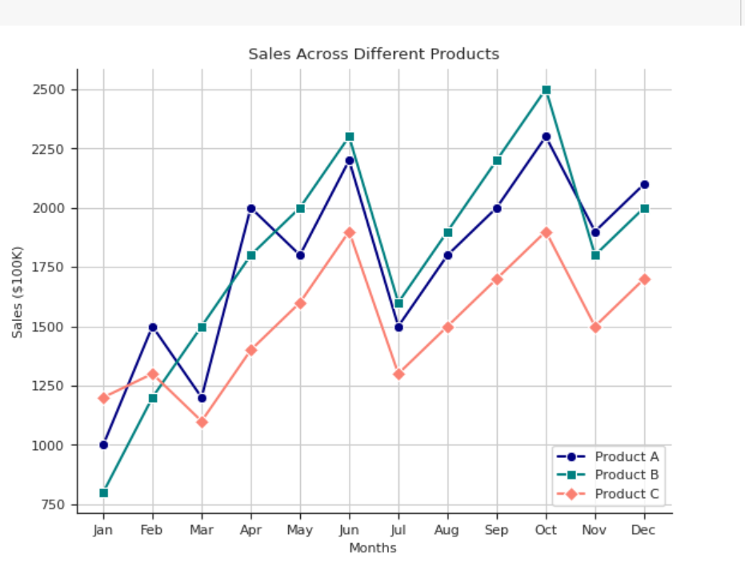
Comparison plots: Line plot
Line plots show the evolution of numerical data by building line segments between points
You can add multiple variables to a line plot using color

Slide 33
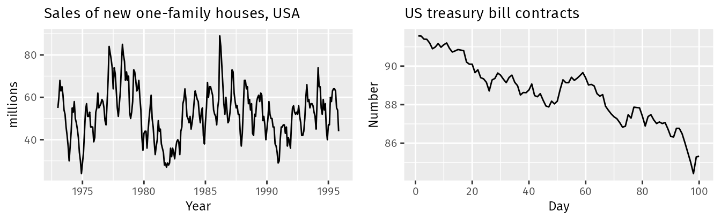
Comparison plots: Line plot
Line plots are used to identify trends and seasonal patterns in time series data (indexed by time)
Seasonal pattern
Trend

Slide 34
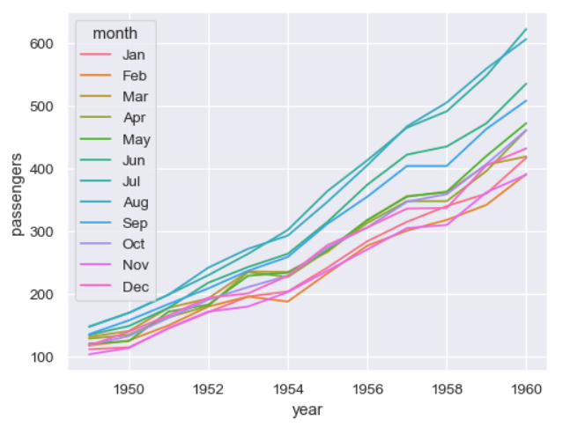
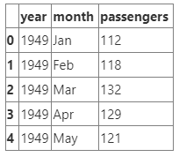
Line plot with Seaborn

Slide 35
Comparison plots: Bar plot
Bar plots represents categorical data with rectangular bars. Each bar usually represents a potential value of the data.

Slide 36
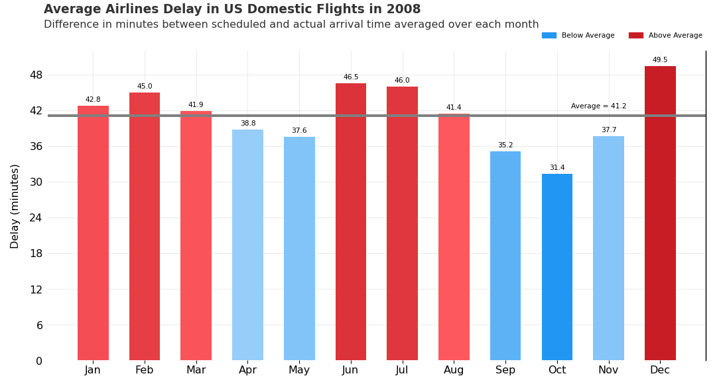
Comparison plots: Bar plot
Bar plots represents categorical data with rectangular bars. Each bar usually represents a potential value of the data.
Make numerical comparisons between different categories

Slide 37
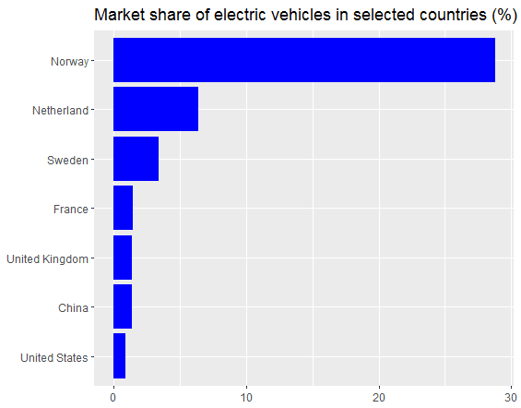
Comparison plots: Bar plot
Bar plots represents categorical data with rectangular bars. Each bar usually represents a potential value of the data.
Make numerical comparisons between different categories
Bars can be represented horizontally or vertically

Slide 38
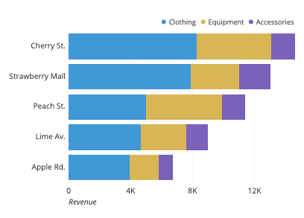
Comparison plots: Stacked bar plot
Stacked bar plots extend standard bar plot by looking at numerical values across two categorical variables
Sub-bars (colors) represent the categories of the second variable
Revenue per store and product type

Slide 39
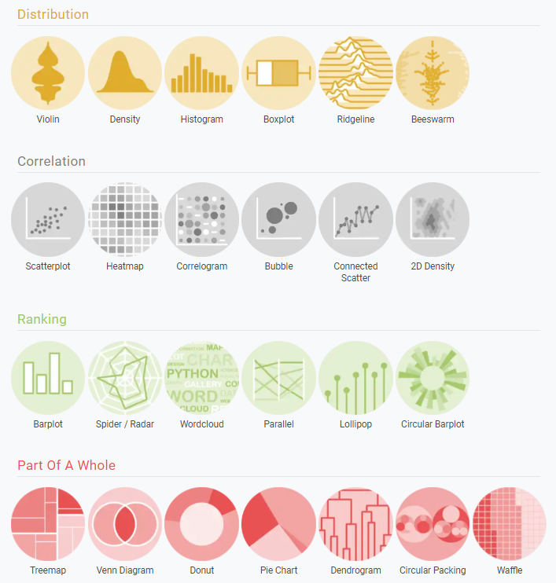
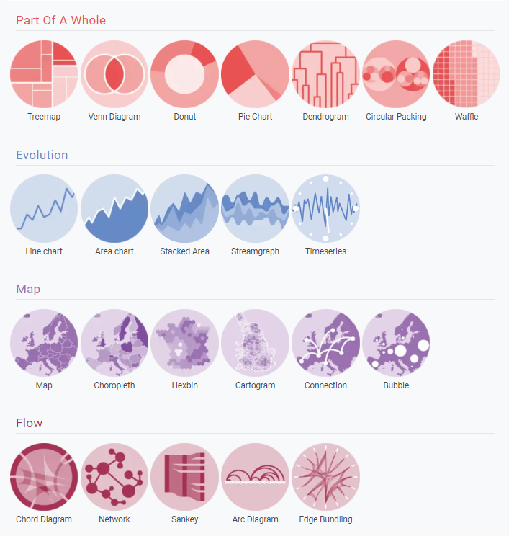
More plots: Python graph gallery
https://python-graph-gallery.com/

Slide 40

Exploratory Data Analysis (EDA)

Slide 41
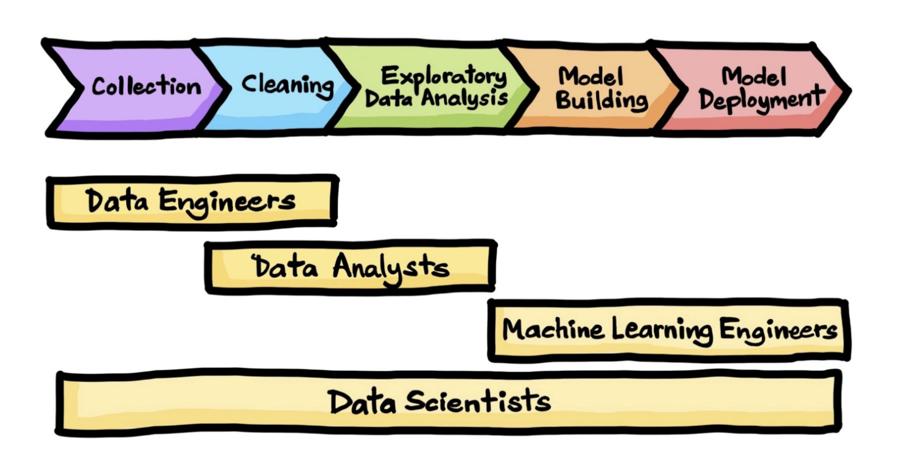
What is Exploratory Data Analysis (EDA) ?
Exploratory Data Analysis is the process of performing initial investigations on data with the help of summary statistics and graphical representations

Slide 42
What is Exploratory Data Analysis (EDA) ?
Exploratory Data Analysis is the process of performing initial investigations on data with the help of summary statistics and graphical representations
Why is it useful ?
Understand the data better
Uncover underlying patterns or biases
Detect anomalies or extreme values
Check assumptions before building a predictive model

Slide 43
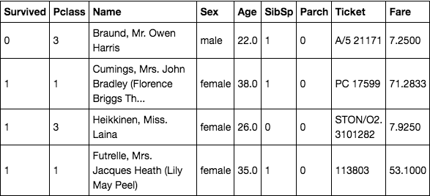
What is Exploratory Data Analysis (EDA) ?
We will use the titanic prediction dataset as an example for Exploratory Data Analysis (EDA).
Goal is to predict whether a passenger survived the titanic

Slide 44
Types of Exploratory Data Analysis
Univariate Analysis
Study the characteristics of the dataset’s variables individually
Examples:
Number of missing values
Data types (int/float, object, …)
Frequency of possible values (categorical data)
Summary statistics (continuous data)

Slide 45
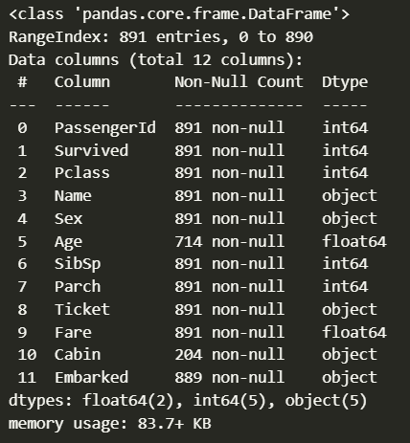
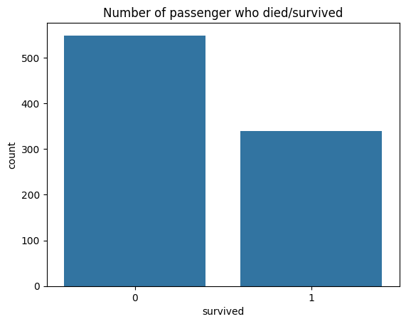
Types of Exploratory Data Analysis
Number of non-missing values
Univariate Analysis
Pandas dtypes
Frequency of each category
Get the number of passenger that died and survived
Missing values & data types
Get general information on the data

Slide 46
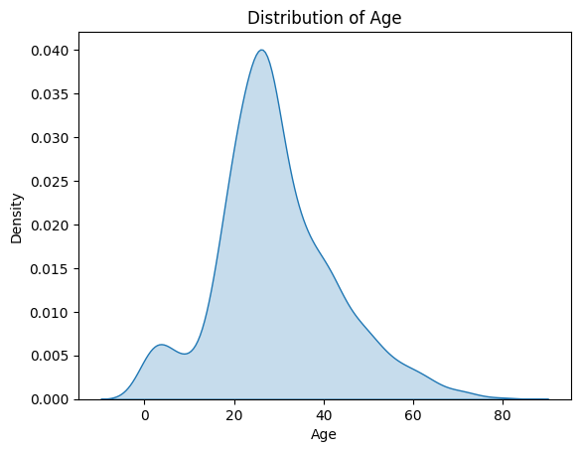
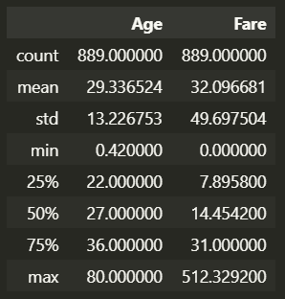
Types of Exploratory Data Analysis
Univariate Analysis
Statistical analysis
Compute summary statistics for Age and Fare
Individual distribution
Study the range skewness of ages in the data

Slide 47
Types of Exploratory Data Analysis
Bivariate Analysis
Analyze the relationship between two variables in the dataset
Detect unknown patterns/trends between two variables
Understand how a variable could explain the variable you are trying to predict (for a predictive analysis)

Slide 48
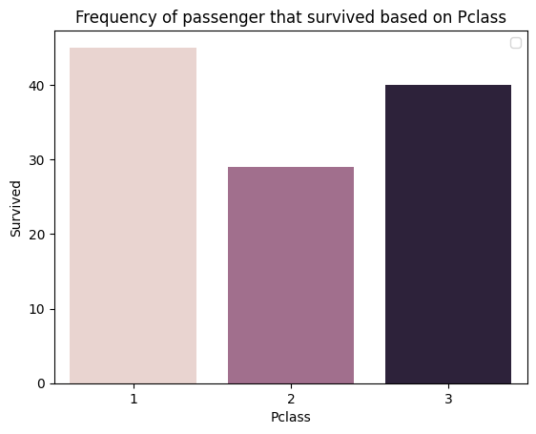
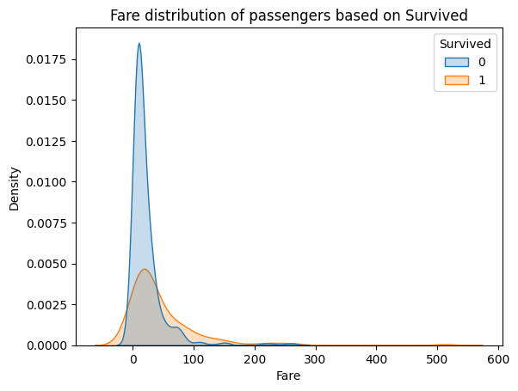
Types of Exploratory Data Analysis
Bivariate Analysis
2 categorical variables
Plot the number of passengers that “Survived” based on the passenger’s class
1 continuous and 1 categorical
Split the Fare distribution based on the “Survived” values

Slide 49
Types of Exploratory Data Analysis
Multivariate Data Analysis
Study the relationship between multiple variables in the dataset

Slide 50
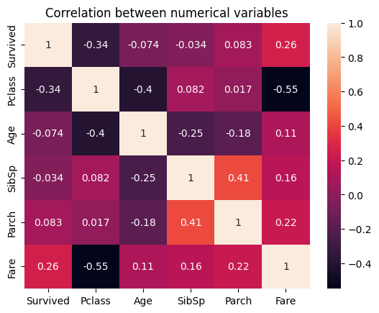
Types of Exploratory Data Analysis
Multivariate Data Analysis
Study the relationship between multiple variables in the dataset
An example of Multivariate Analysis are correlation (heatmap) plots
Detect redundant variables or strong correlations with the variable to predict

Slide 51


Thank you for listening !
Do you have any questions ?

